Slide 1

Key Stage 2 SATs
Presentation to Parents

Slide 2
What are KS2 SATs?
KS2 SATs are tests children take at the end of Year 6. Key Stage 2 SATs test children on what they have learnt between Year 3 and Year 6.
KS2 SATs are mandatory tests from the National Curriculum assessment programme. All state schools in England are required to provide the tests.
SATs are used to reflect the level at which your child is working.

Slide 3
click to see all text
Scaled Scores
What is meant by ‘scaled scores’?
‘100’ will represent the ‘national standard’.
Each pupil’s raw test score will therefore be converted into a score on the scale, either at, above or below 100.
The scale will have a lower end point somewhere below 100 and an upper end point above 100.
A child who achieves the ‘national standard’ (a score of 100) will be judged to have demonstrated sufficient knowledge in the areas assessed by the tests.
In July 2022 each pupil will receive:
A raw score (number of raw marks awarded).
A scaled score in each tested subject.
Confirmation of whether or not they attained the national standard.
next page

Slide 4
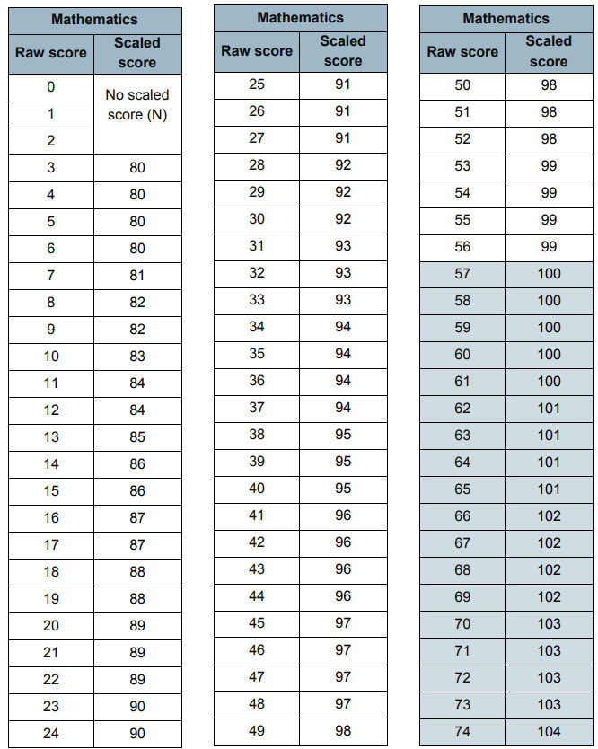
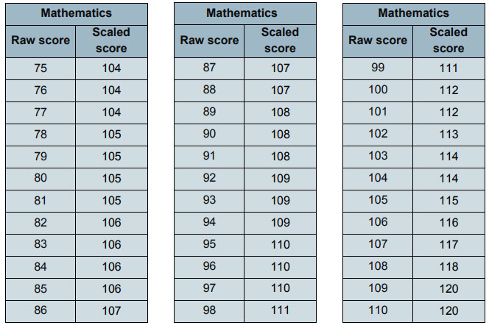
click to see all text
Scaled Scores
next page

Slide 5
click to see all text
Scaled Score Examples
On publication of the test results in July 2022:
A child awarded a scaled score of 100 is judged to have met the ‘national standard’ in the area judged by the test.
A child awarded a scaled score of more than 100 is judged to have exceeded the national standard. A score of 110 or above is an indication that a child is ‘working at greater depth.’
A child awarded a scaled score of less than 100 is judged to have not yet met the national standard and performed below expectation for their age. This is also referred to as ‘working towards the national standard.’
next page

Slide 6
click to see all text
The Tests
Key Stage 2 SATs take place nationally in the week commencing 9th May 2022.
Statutory tests will be administered in the following subjects:
MONDAY
Punctuation, Vocabulary and Grammar (45 minutes)
Spelling (approximately 20 minutes)
TUESDAY
Reading (60 minutes)
WEDNESDAY
Mathematics
- Paper 1: Arithmetic (30 minutes)
Paper 2: Reasoning (40 minutes)
THURSDAY
- Paper 3: Reasoning (40 minutes)
All tests are externally marked.
Writing will be ‘Teacher Assessed’ internally, as in recent years.
next page

Slide 7
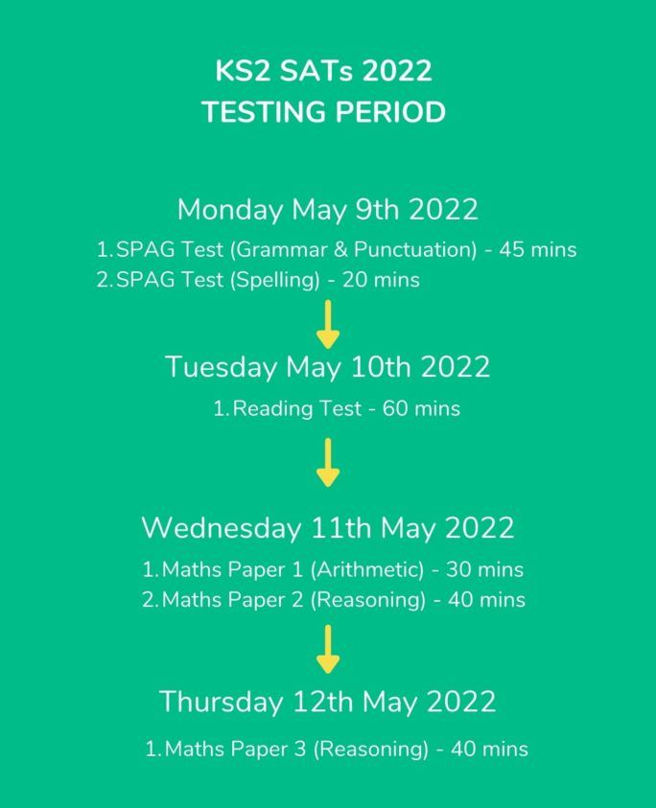
Here is the timetable for the KS2 SATs week

Slide 8
click to see all text
Spelling, Punctuation and Grammar
A separate test is given on Punctuation, Vocabulary and Grammar
This test lasts for 45 minutes and requires short answer questions, including some multiple choice.
A Spelling test is administered containing 20 words, lasting approximately 15-20 minutes.
Marks for these two tests are added together to give a total for Spelling, Punctuation and Grammar.
next page

Slide 9
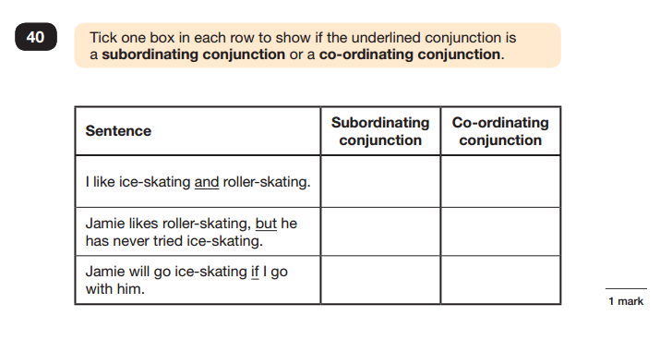
Sample Questions
Grammar, Punctuation and Spelling Paper 1
next page

Slide 10
Scores
Grammar, Punctuation and Spelling
The spelling test is out of 20.
The grammar test is out of 50.
This will give children a total out of 70.
In 2018 to meet the expected standard children needed to score at least: 38/70
To achieve greater depth children needed to score at least: 56/70
In 2019 to meet the expected standard children needed to score at least: 36/70
To achieve greater depth children needed to score at least: 55/70
There is no way of knowing at this stage what this threshold will be for 2022.
next page

Slide 11
click to see all text
Reading
The Reading Test consists of a single test paper with three unrelated reading texts.
Children are given 60 minutes in total, which includes reading the texts and answering the questions.
A total of 50 marks are available.
Questions are designed to assess the comprehension and understanding of a child’s reading.
Some questions are multiple choice or selected response, others require short answers and some require an extended response or explanation.
next page

Slide 12
click to see all text
Reading
There is only one reading test and this is out of 50.
In 2018 to meet the expected standard children needed to score at least: 28/50
To achieve greater depth children needed to score at least: 40/50
In 2019 to meet the expected standard children needed to score at least: 28/50
To achieve greater depth children needed to score at least: 41/50
next page

Slide 13
click to see all text
Mathematics
Children will sit three tests: Paper 1, Paper 2 and Paper 3.
Paper 1 is for ‘Arithmetic’ lasting for 30 minutes, covering calculation methods for all operations, including use of fractions, percentages and decimals.
Questions gradually increase in difficulty. Not all children will be expected to access some of the more difficult questions later in the paper.
Papers 2 and 3 cover ‘Problem Solving and Reasoning’, each lasting for 40 minutes.
Pupils will still require calculation skills but will need to answer questions in context and decide what is required to find a solution.
next page

Slide 14
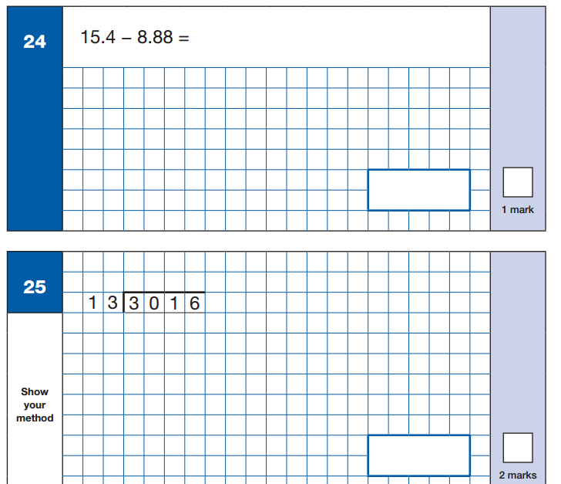
Sample Questions
Maths Paper 1: Arithmetic
chapter
menu
next page

Slide 15
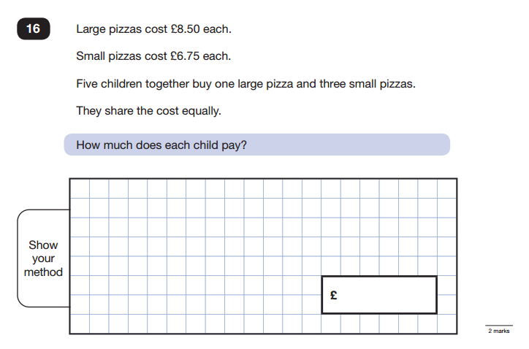
Sample Questions
Maths Paper 2 / Paper 3 : Reasoning
chapter
menu
next page

Slide 16
click to see all text
Mathematics
Arithmetic paper is out of 40
Each reasoning paper is out of 35
There are a total of 110 marks available
In 2018 to meet the expected standard children needed to score at least: 61/110
To achieve greater depth children needed to score at least: 96/110
In 2019 to meet the expected standard children needed to score at least: 58/110
To achieve greater depth children needed to score at least: 95/110
next page

Slide 17
WRITING
Throughout the year the children will be composing independent pieces of writing to build up a portfolio of evidence. This is assessed by the class teacher.
This body of work will cover a range of genres that have been taught in class and provide evidence of the writing skills necessary to meet the expected standard.
Some children will be able to apply the skills consistently across most genres and will therefore be working at greater depth within the expected standard (GDS).

Slide 18
click to see all text
What are the SATs results for?
- They measure the progress a child has made since their KS1 SATs
They give an indication to secondary schools as to those children who may need extra support.
Almost all secondary schools group children into sets or streams based on their academic ability, and SATs results may be used as part of the decision-making process. (However, some secondary schools will use their own testing system for pupils in Year 7 to help with this.)
Secondary schools also use SATs results to work out their Progress 8 score. This is a performance measure of how well pupils progress between Year 6 and Year 11, with their SATs results as a starting point.
More information on this can be found here:
https://www.theschoolrun.com/what-are-sats-results-for
next page

Slide 19
click to see all text
How to Help Your Child
Praise and encourage.
Ensure your child has the best possible attendance at school.
Support your child with any homework tasks.
Spellings and arithmetic (e.g. times tables) are always good to practise.
Talk to your child about what they have learnt at school and what book(s) they are reading (the character, the plot, their opinion).
Use revision guides and practice books – if you would like to.
next page

