Slide 1
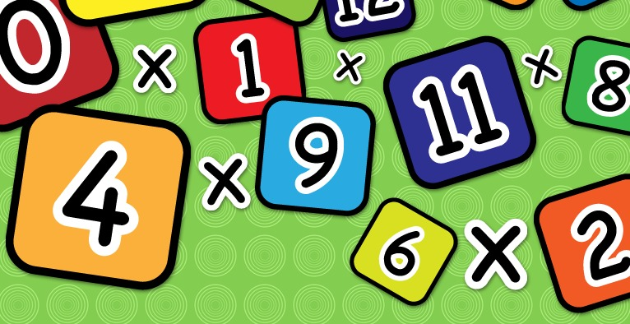
Year 4 Multiplication Tables Check
Information for Parents

Slide 2
What is the purpose of the multiplication tables check?
To determine whether year 4 pupils can fluently recall their multiplication tables.
To help schools to identify pupils who require additional support.

Slide 3
When will the multiplication tables check be carried out?
There will be a 3-week window in June (6-24 June 2022) for the check to be carried out.
There is no set day to administer the check.
Children will not all take the check at the same time.

Slide 4
How is the multiplication tables check carried out?
The check will be fully digital and take place on screen. (Children will use iPads or laptops.)
Answers will be entered by pressing digits using a touchscreen with an on-screen number pad or by pressing the number keys on a keyboard.
The multiplication check will take less than 5 minutes per pupil.
Children will get 6 seconds from the time the question appears to input their answer.
There will be 25 questions with a 3 second pause in-between questions.
Each pupil will be randomly assigned a set of questions.
Children will only face multiplication statements in the check (not related division facts).

Slide 5
Which multiplication facts will be included?
There will always be questions from the 3, 4, 5, 6, 7, 8, 9, 11 and 12 multiplication tables.
There will be no questions from the 1 times table (for example: 1 x 8 or 8 x 1).
The 6, 7, 8, 9 and 12 times tables are more likely to be asked.
There will only be a maximum of 7 questions from the 2, 5 and 10 times tables.

Slide 6
Questions more likely to appear
The following multiplication questions are more likely to be asked:
  6 x 6, 6 x 7, 6 x 8, 6 x 9, 6 x 12
  7 x 7, 7 x 8, 7 x 9, 7 x 12
  8 x 8, 8 x 9, 8 x 12
  9 x 9, 9 x 12
  12 x 12

Slide 7
Examples of the test
TTRockstars – Soundcheck activity
PurpleMash – Multiplication Assessment
Mathsframe - https://mathsframe.co.uk/en/resources/resource/477/Multiplication-Tables-Check

Slide 8
How is school helping the children to prepare for the check?
Times tables games and activities are used regularly in Maths lessons.
Maths homework will partly focus on practising times tables.
Multiplication tables tests are held regularly in class.
Children have access to TTrockstars at home and in school.
A test similar to the June test will be used regularly to familiarise the children with the format.

Slide 9
What can you do to help your child at home?
Firstly, a positive attitude goes a long way – so as much encouragement and support as possible!
Make practising the times tables fun!
  Climb stairs counting in multiples
  Play verbal times tables games
  Listen to and learn times tables songs
  Take it in turns to say different times tables in funny voices (i.e. say 2 x 3 = 6 in a lion’s voice)
  Use TTrockstars and Purplemash - they really do help with speed and accuracy!

Slide 10
How will I find out my child’s result?
The children’s individual scores will be reported to parents before the end of the summer term.
Schools have not been given a ‘pass mark’ or threshold for the check.

Slide 11
What if my child is worried about the test?
Talk
Talk directly to the class teachers if you have any questions or worries (try not to worry your child).
Encourage
Encourage your child to talk to you, their teachers, or another adult they trust, if they express persisting anxieties about the check.
Remember
Remember that a small amount of anxiety is normal.

Slide 12
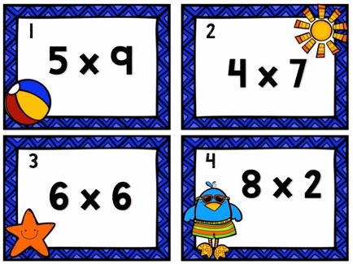
Remember
This check is only about times tables facts. It does not reflect your child’s understanding of wider mathematical topics.
Speed is important for this test, but it isn’t everything!
The check is only 5 minutes long. When they have finished, your child will not need to repeat the check, regardless of their final score.

