Slide 1
KS1 SATs
2022
Things we will cover:
What SATs in Key Stage 1 are.
What the SATs tests look like.
How teachers assess.
Age related expectations.
What you can do to help.
A parents guide.

Slide 2
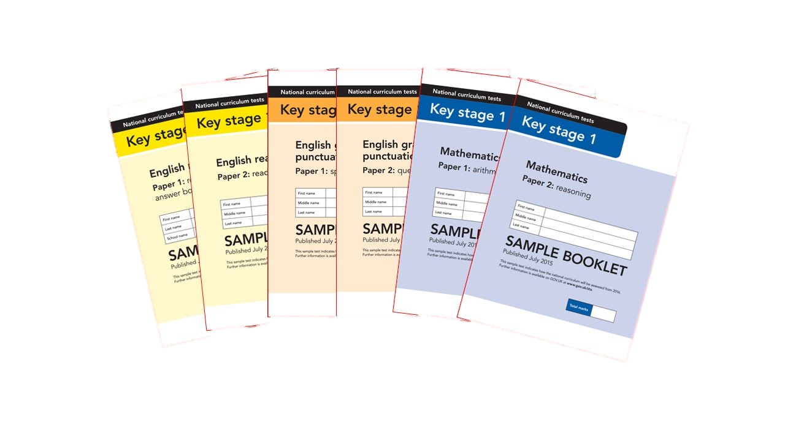
What are Sats?
In May of this year, all Year 2 children will take assessments in:
English – Reading
Maths – Arithmetic and Reasoning
These tests reflect the National Curriculum and are marked internally within school.
Each pupil’s test score is then converted into a score on a scale, either at, above or below 100.
It is planned that 100 will always represent the ‘national standard’.

Slide 3
An outline of the tests
Paper 1
Paper 2
Reading booklet with
questions and answer spaces
combined.
Reading booklet with a separate booklet which has the questions and answer spaces.
English Reading
(Texts totalling 400 – 700 words)
(Texts totalling 800-1100 words)
Each paper for the KS1 Reading SATs is worth 50% of the available marks.

Slide 4
Reading
The reading test consists of two separate papers:
Paper 1 consists of a combined reading prompt and answer booklet. The paper includes a list of useful words and some practice questions for teachers to use to introduce the contexts and question types to pupils. The test takes approximately 30 minutes to complete but is not strictly timed.
Paper 2 consists of an answer booklet and a separate reading booklet. There are no practice questions on this paper. Teachers can use their discretion to stop the test early if a pupil is struggling. The test takes approximately 40 minutes to complete but is not strictly timed.
The texts will cover a range of poetry, fiction and non-fiction.
Questions are designed to assess the comprehension and understanding of a child’s reading.
There are a variety of question types:
Multiple Choice
Ranking/Ordering
Matching/Labelling
Short-Answer Questions
Find and Copy Questions
Open-Ended Questions

Slide 5
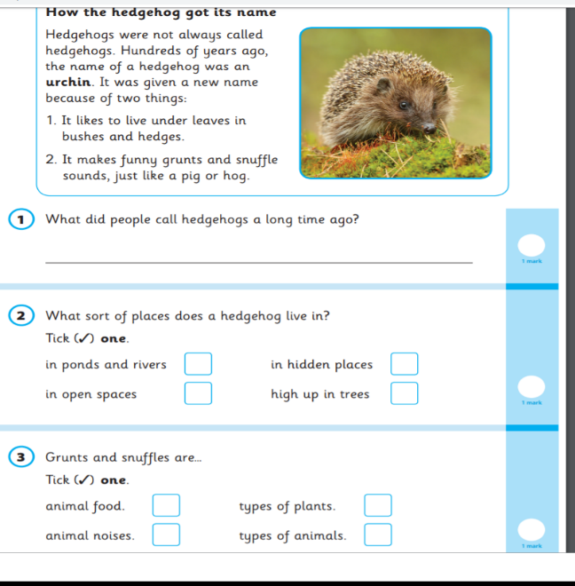
English – Reading
Paper 1 Example Page

Slide 6
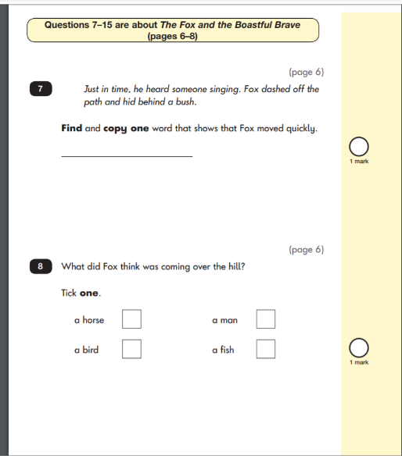
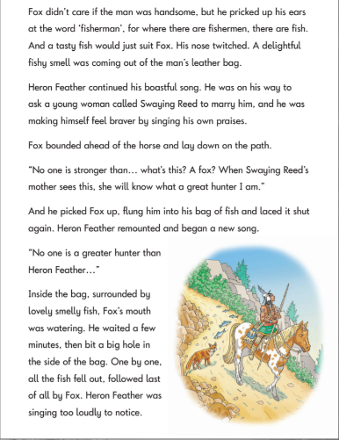
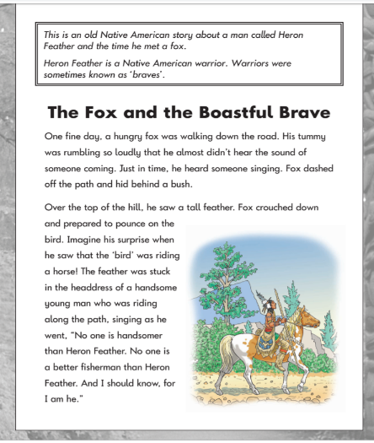
English – Reading
Paper 2 Example Pages

Slide 7
Maths
Paper 1
Paper 2
Arithmetic
Reasoning, problem solving and mathematical fluency
Arithmetic
& Reasoning
(25 marks available)
(35 marks available)

Slide 8
Maths
The maths assessment consists of 2 papers, arithmetic and reasoning.
Paper 1 is the Arithmetic paper and that lasts approximately 20 minutes (although this is not strictly timed). The paper assesses pupil’s confidence with fluency, whole numbers, fractions, place value and counting. It also covers calculation methods for the 4 operations – addition, subtraction, multiplication and division.
Paper 2 is the Reasoning paper and this lasts for approximately 35 minutes, which includes time for five aural questions. Pupils will still require calculation skills and questions will be varied including multiple choice, matching, true/false, completing a chart or table or drawing a shape. Some questions will also require children to show or explain their working out.

Slide 9
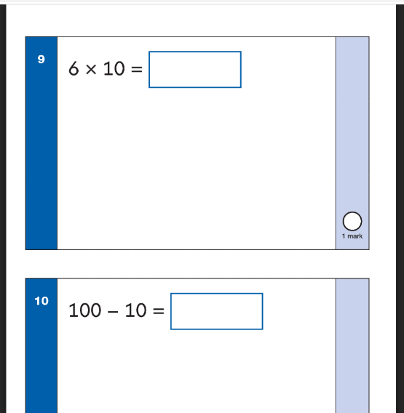
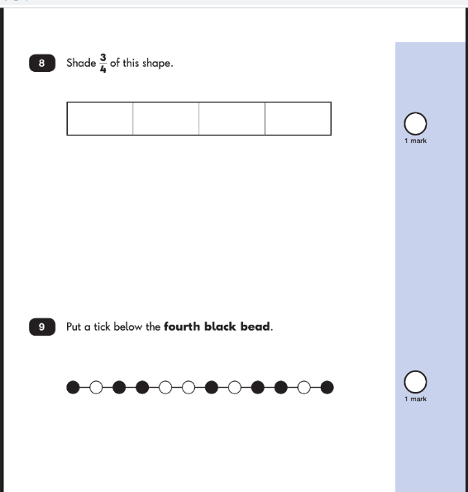
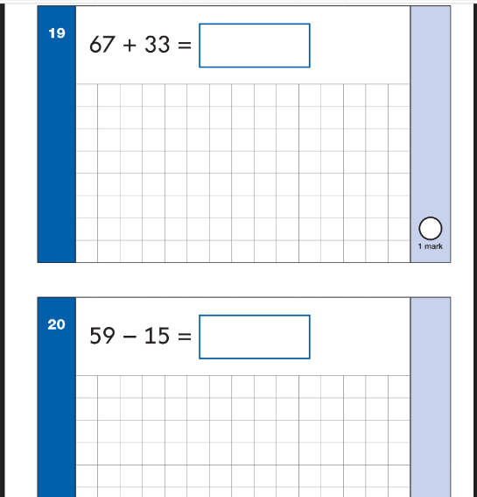
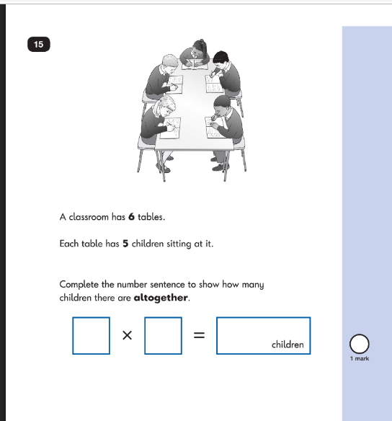
Maths Paper 1 Example Pages (Arithmetic)
Maths Paper 2 Example Pages (Reasoning)

Slide 10

Teacher assessment/results.
KS1 SATs tests are one part of evidence towards the whole teacher assessment.
They are marked in school and used to support an overall decision about where your child is working, based on the whole year’s work.

Slide 11
Age Related Expectations
Working below the expected standard (not working within the Year 2 Curriculum).
Working towards the expected standard (some of the learning is within the Year 2 Curriculum).
Working at the expected standard (All learning is within the Year 2 Curriculum).
Working at greater depth (Very secure in Year 2 Curriculum and demonstrates much deeper learning).

Slide 12
How can you help your child prepare?
Reading Listening to your child read can take many forms:
First and foremost, focus developing an enjoyment and love of reading.
Enjoy stories together – reading stories to your child is equally as important as listening to your child read.
Read a little at a time but often, rather than rarely but for long periods of time!
Talk about the story before, during and afterwards – discuss the plot, the characters, their feelings and actions, how it makes you feel, predict what will happen and encourage your child to have their own opinions.
Look up definitions of words together – you could use a dictionary, the Internet or an app on a phone or tablet.
All reading is valuable – it doesn’t have to be just stories! Reading can involve anything from fiction and non-fiction, poetry, newspapers, magazines, football programmes, TV guides.
Visit the local library - it’s free!

Slide 13
How can you help your child prepare?
Maths:
Play mental maths games including counting in different amounts, forwards and backwards.
Encourage opportunities for telling the time.
Encourage opportunities for counting coins and money. E.g: finding amounts or calculating change when shopping.
Look for numbers on street signs, car registrations and anywhere else.
Look for examples of 2D and 3D shapes around the home.
Identify, weigh or measure quantities and amounts in the kitchen or in recipes.
Play games involving numbers or logic, such as dominoes, card games, draughts or chess.

Slide 14
How can you help your child prepare?
Generally:
First and foremost, support and reassure your child that there is nothing to worry about and that they should always just try their best. Praise and encourage!
Ensure your child has the best possible attendance at school.
Support your child with any homework tasks.
Reading, spelling and arithmetic (e.g. times tables) are always good to practise.
Talk to your child about what they have learnt at school and what book(s) they are reading (the character, the plot, their opinion).
Make sure your child has a good sleep and healthy breakfast every morning!

Slide 15

Thank You!

