Slide 1


Year 1 Phonics Screening Check

Slide 2
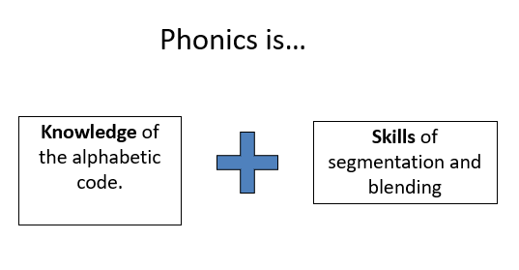
What is Phonics and why do we teach it?
The evidence is clear that the teaching of systematic synthetic phonics is the most effective way of teaching young children to read, particularly for those at risk of having problems with reading. Unless children have learned to read, the rest of the curriculum is a secret garden to which they will never enjoy access.
The Importance of Teaching : The Schools White Paper 2010

Slide 3
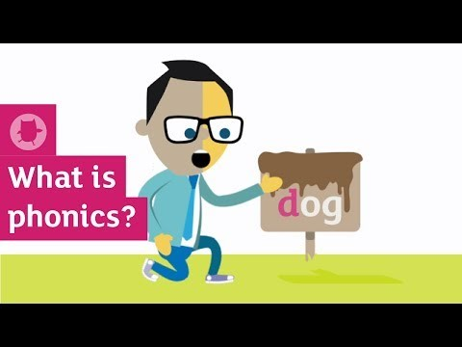
Watch this fun animation to find out about phonics and understand the key aspects of learning to read using phonics.
https://youtu.be/42jb6PopZCI

Slide 4
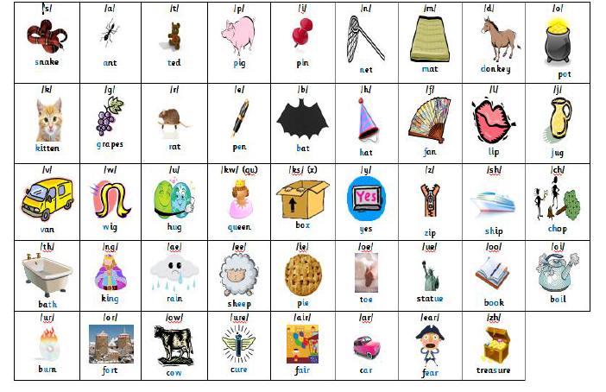
The 44 sounds of the English Language

Slide 5

What is The Phonics Screening Check?
Children in Year 1 throughout the country will all be taking part in a phonics screening check during the same week in June. Children in Year 2 will also take the check if they did not achieve the required result when in Year 1, or if they have not taken the test before.
The phonics screening check is designed to
confirm whether individual children have learnt
sufficient phonic decoding and blending skills to
an appropriate standard.

Slide 6
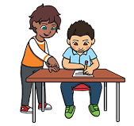
What happens during the test?
The test contains 40 words.
Each child will sit one to one with Mrs Kelsall or
Mrs Jennings and read each word aloud.
The test takes approximately 10 minutes, although
each child is different and they will all be allowed to complete
at their own pace.
The list of words the children will read from is a combination of 20 real words and 20 pseudo words (nonsense words).

Slide 7

Pseudo Words (Nonsense/Alien words)
The 20 pseudo words will be shown to your child with a picture of an alien. This provides the children with a context for the pseudo word which is independent from any existing vocabulary they may have.
The real words will be presented on a plain
background with no aliens or pictures.

Slide 8
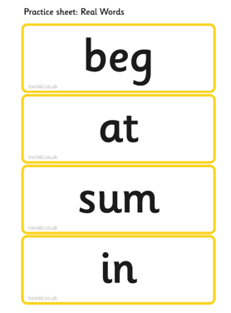
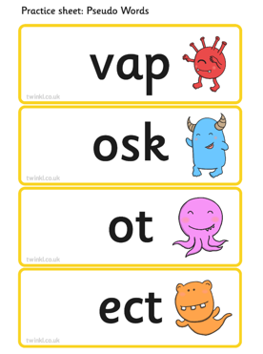
Examples of how the check will be presented to your child.

Slide 9
The Results of the Check
The pass mark for the expected standard changes each year but it is usually between 30-32 marks.
We will report your child’s result in the end of year reports in July.
If your child has not reached the expected standard they will re -take the check in Year 2.

Slide 10

How to support your child at home
Read as much as possible to and with your child.
Play lots of sound and listening games with your child.
Encourage and praise.
In order to support your chid at home it is important that you pronounce the sound correctly. Check out Mr Thorne for some great videos on You Tube that will help you and your child.
https://www.youtube.com/channel/UC7sW4j8p7k9D_qRRMUsGqyw

Slide 11
Other useful links
https://home.oxfordowl.co.uk/english/primary-english-year-1-age-5-6/
https://home.oxfordowl.co.uk/at-school/primary-school-assessment-tests/year-1-phonics-screening-check/
https://www.phonicsplay.co.uk/ - We use this in school but there is also a parent section. There are some great games to play that practise for the phonics screening check Eg Picnic on Pluto and Buried Treasure.
We have also included on the website some sample practise papers and a phonics glossary list.

