Slide 1
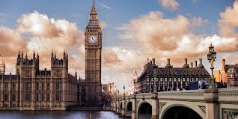
Year 5 Trip to London

Slide 2
Key Information
Monday 8th and Tuesday 9th June
Staff: Mrs Waterhouse, Mrs Gregory, Mr Bowden, Mrs Bennett and Mrs Chip
The train departs Lancaster Train Station at 7.41am on Monday 8th June.
The train back will arrive at Lancaster Train Station at 8.55pm on Tuesday 9th June.

Slide 3
Dropping Off
Please drop your child off at Lancaster Train Station main entrance between 7.15am and 7.25am.
Members of staff will be waiting to meet your child in the main entrance by the ticket office.
You will be able to leave your child with us and we will then escort them down to the platform at 7.25am.
Please do not be late – we cannot wait!

Slide 4
Itinerary
Day 1:
British Museum (we will eat our packed lunch in the museum)
Walking tour of main sights of London (Covent Garden, Leicester Square, Trafalgar Square, Buckingham Palace, Downing Street, Parliament Square Gardens).
Dinner at St Paul’s YHA
Theatre trip to ‘Paddington’

Slide 5
Itinerary
Day 2:
Breakfast at the YHA
London Eye
Lunch in Jubilee Gardens (provided by YHA)
London River Cruise
Science Museum
Dinner at Euston Station before catching the train home

Slide 6
Transport
We will be walking where we can so please make sure that your child is wearing comfortable walking shoes!
We will be using the underground on both days.
We have allocated seating on the Lancaster to Euston and Euston to Lancaster train.

Slide 7
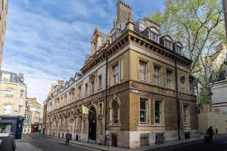
Accommodation
We are staying in St Paul’s Youth Hostel which is next to St Paul’s Cathedral.
Rooms have been allocated.

Slide 8
What to bring
The children will need to carry their own bags with them around London so please pack light in a small rucksack!
All they will need to bring is:
One change of clothes (the smaller/lighter the better)
Toothbrush and toothpaste, hairbrush, wash stuff
Pyjamas
Water bottle
Lunch for the first day (please in a bag that can be thrown away – no lunchboxes)
Waterproof jacket
Sun cream
Optional spending money (no more than £10)
Anything else that they bring they will need to carry with them whilst walking round London so please think very carefully if it is necessary!
Children are not allowed to bring anything electronic (phones, games etc) or anything valuable.

Slide 9
Medication
Any medication needs to be handed to their designated adult – please discuss with us beforehand what medication they will be bringing and we can tell you which adult you will need to find at the train station.

Slide 10
Safety and Supervision
Children will be in groups of six with a designated adult for each group. They will stay with their assigned group and adult at all times.
Children will follow rules for walking near roads, crossings and public transport.
We will be together at all times and all adults will be made aware of meeting points when walking if needed.
Children will wear their caps and wristbands throughout the trip.
Each section of the trip has been fully risk assessed.

Slide 11
Behaviour and Expectations
Children will be expected to follow our school behaviour policy at all times.
This includes:
Following adult instructions immediately
Showing respect to staff and volunteers, other pupils and members of the public.
Use of kind, polite language at all times
Walking sensibly and staying with their group.
Treating venues, transport and accommodation with care and respect.
We will also be reminding children about behaviour in public places.
London venues will be busy and shared with the public
Pupils are expected to:
  Walk calmly
  Speak quietly indoors
  Respect queues and seating
Any behaviour that puts safety at risk will be addressed immediately

Slide 12
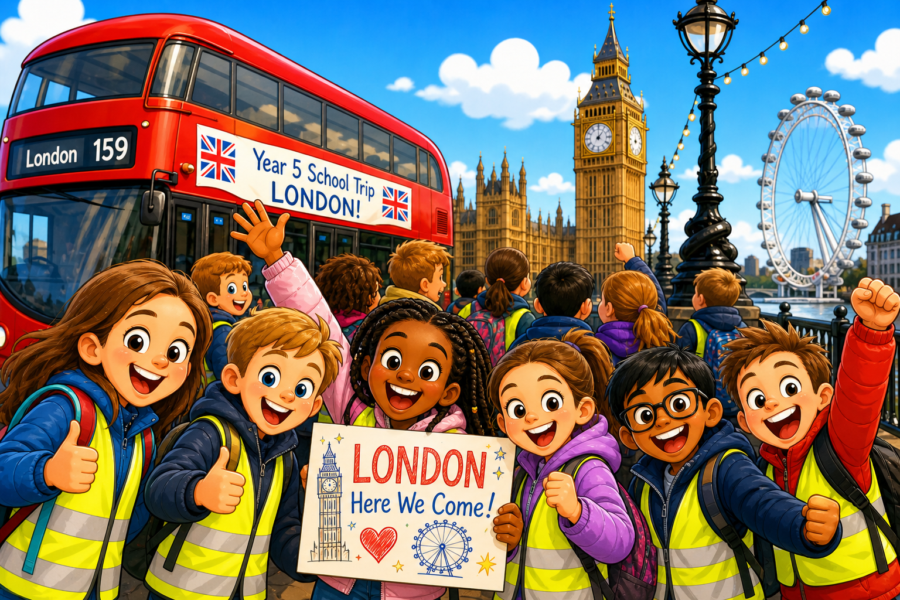
Have fun!

Slide 13

Any Questions?

